Slide 1
Dear Mr. President,
Do You Remember When You Said…

Slide 2
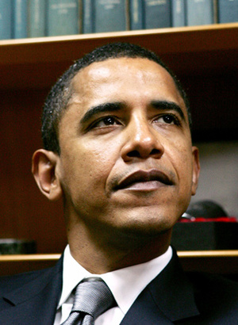
That You Were Going To Bring Change To America…

Slide 3
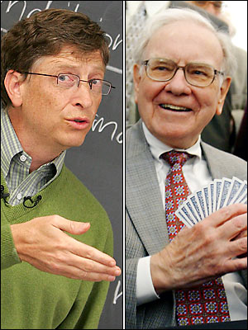

By Lowering Taxes
For Working Class Families…
And Taxing the Upper Class Appropriately...

Slide 4
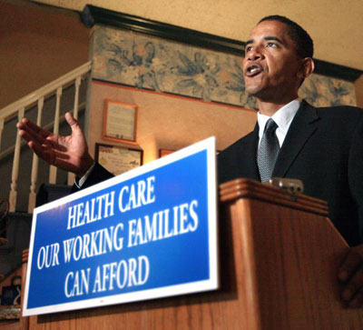
..And By Making Healthcare More "Affordable" , and "Accessible" For All Of Us.

Slide 5
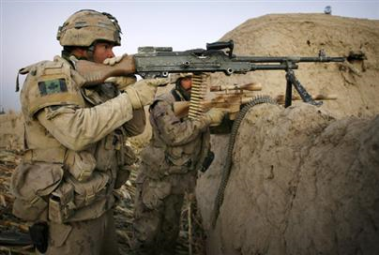
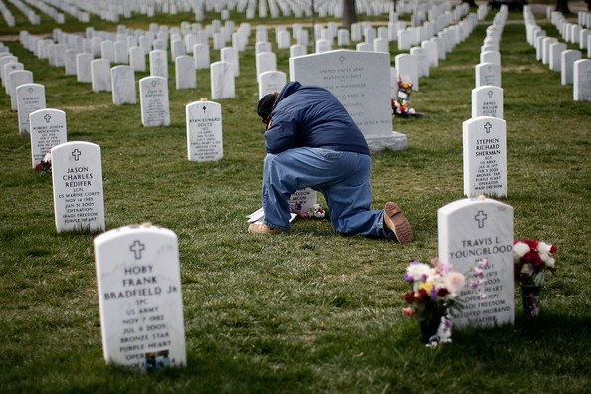
I Hope That You Are Still Going To Bring The Troops Home From Iraq;Where A Vast Amount Of Lives Were Lost, And Focus Solely On The "Forgotten" War In Afghanistan In Which You Plan To Capture Those Who Have Threathened Our Country.

Slide 6
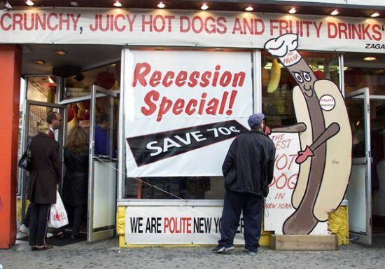
What I Am Concerned About The Most Is The Promises You Made About the Economy....

Slide 7
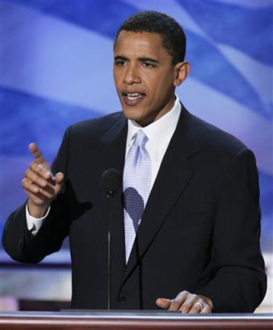
…And How It Will Get Better In Time. You Said That You Were Going To Achieve This By Creating More Jobs, Giving Tax Relief To Working Class Families, Supporting Small Business, Protecting Against Mortgage Fraud (those are only a couple of things.)

Slide 8
JUST SO YOU KNOW…

Slide 9

…You Are Already In Our Hearts And Homes. Please, Do Not Let Us Down. I Do Not Think That We Can Handle Anymore Disappointment.You Seem To Be Like What We Need To Prosper Again.

