Slide 1
My Presidential Minute
By: Heena

Slide 2
My 1st issue
Illegal people should get legal
They will have no related problems
Will get a job
They will have money for there basic needs

Slide 3
Illegal to legal
People want job for there family
People are really stuck in home if they are not legal
Also then people can’t meet there family
The attack that happened in India illegal people cannot go back
One of the main thing is that they are suffering from many things.
Because I hear this in news and in newspaper I feel bad for those people. (the India aboard newspaper)

Slide 4
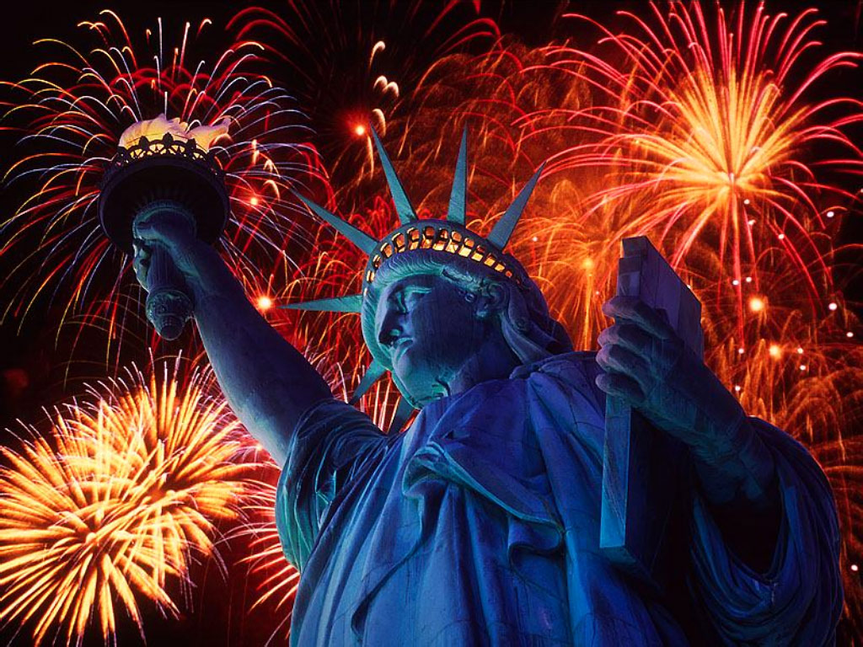
Peoples Freedom
People are stuck in home because of the illegal
Then people can’t meet there friends or there family and they miss them.
And one of the 3rd is that they can’t go anywhere because the illegal and there is no use living.

Slide 5
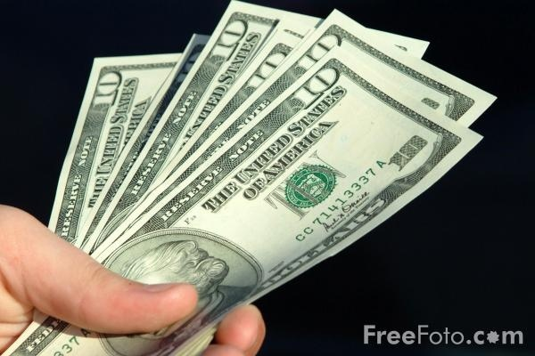
Money Problems
People have no money because they don’t have job and that is because of the papers.
People cant buy their food or other things that are important.
then they also pay the rent and the bill I don’t think that is fair.

Slide 6
Student Health Insurance
The health insurance now and the students can’t pay that much
It should be less money and all or as much of the student that can covers should get the insurance

Slide 7
3 Reasons For Health Insurance
Student should get the insurance
If they get injured can save money
And then people should afford it.

Slide 8
Explanation
First they should get it because kids get hurt and sick and have to pay for there study’s and the text books and other million stuffs.
if they do get it, it is easier for them and won’t spend that much money on the other stuff.
and even if we start the health insurance the cost should get less.

Slide 9
My last opinion on the medicines
On the medicines it that the prices from the drugs should be less so people and also I can afford it.
It would benefits us by people buying more and getting more money then you will usually will
Then people will be able to pay more tax.
I also heard that people who make the medicines should tell the truth what is in it
you know vitamin D has 5 different cancers

Slide 10
Are America's rank should be category 3 it will give a good benefit to America god bless America

